Slide 1
Chapter 2: Error Handling, Software Testing and Program Efficiency
Data Structures in Java: From Abstract Data Types to the Java Collections Framework
by Simon Gray

Slide 2
Introduction
This chapter looks at three characteristics of programs of interest to us
  robustness: a program’s ability to spot exceptional conditions and deal with them or shutdown gracefully
  correctness: does the program do what it is “supposed to”? Unit testing is one way to verify expected program behavior
  efficiency: all programs use resources (time and space, for example); how can we measure efficiency so that we can compare algorithms?

Slide 3
Things that can go wrong
Logic error – The program does something unintended and the fault lies with something the programmer did ☹
Environment error - Something goes wrong with the environment within which the program is running; outside programmer’s control
I/O error – A source or a destination for data has a problem (e.g., lost network connection). Sometimes you can recover from these problems

Slide 4
Exceptions
Exceptions are Java’s way of telling you something has gone wrong
When an “exceptional condition” occurs, an exception object is created storing information about the nature of the exception (kind, where it occurred, etc.). When this happens, we say that “an exception is thrown”.
The JVM looks for a block of code to catch and handle the exception (do something with it)

Slide 5
Generating an ArithmeticException
Fragment of ExceptionEx.java
8 /**
9 * Compute quotient of numerator / denominator.
10 * Assumes denominator is not 0.
11 */
12 public static int computeQuotient(int numerator,
13 int denominator) {
14 return numerator / denominator;
15 }
_{Enter two integers: 8 0}
Exception in thread “main” java.lang.ArithmeticException: / by zero
at ExceptionEx.computeQuotient(ExceptionEx.java:14)
at ExceptionEx.main(ExceptionEx.java:27)
Result of program run:
stack trace

Slide 6
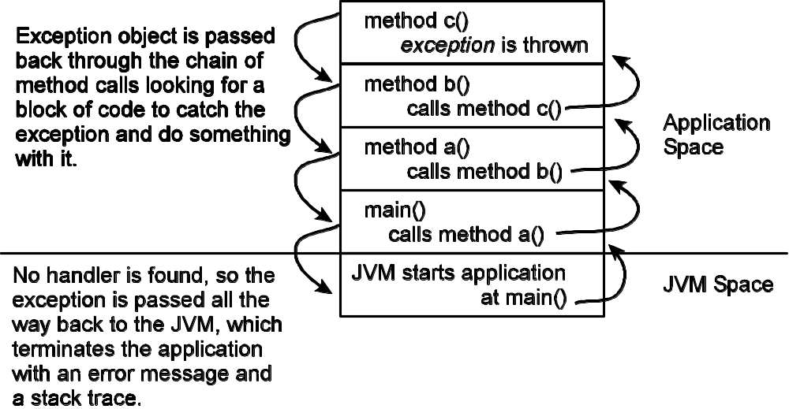
When an exception is thrown

Slide 7
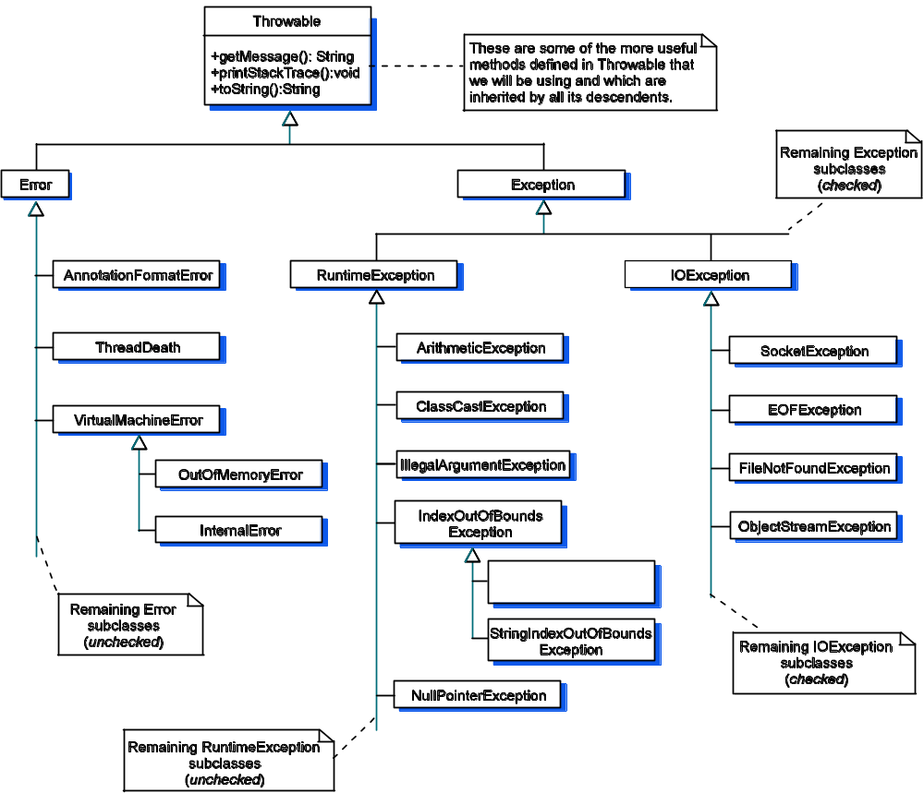
Java’s Exception Hierarchy
remember, this
means extends

Slide 8
Kinds of exceptions
Checked exceptions – descended from class Exception, but outside the hierarchy rooted at RuntimeException. The compiler will check that you either catch or rethrow checked exceptions
Unchecked exceptions – represent the kinds of errors your program can avoid through careful programming and testing. The compile does not check to see that you catch/handle these exceptions.

Slide 9
Try-Catch-Finally Blocks
The first catch block with an
ExceptionTypeX that matches
the type of the exception thrown in the try-block will execute. The other catch-blocks will be skipped. Then the finally-block executes.
try {
program statements; some of which may throw an exception
}
catch ( ExceptionType1 exception ) {
program statements to handle exceptions of type ExceptionType1 or any of its subclasses
}
catch ( ExceptionType2 exception ) {
program statements to handle exceptions of type ExceptionType2 or any of its subclasses
}
. . . // other catch clauses
catch ( ExceptionTypeN exception ) {
program statements to handle exceptions of type ExceptionTypeN or any of its subclasses
}
finally {
this block is optional;
program statements that execute after the try block or a catch block has executed;
this block will execute whether or not an exception is thrown
}

Slide 10
Throwing an Exception
Good for complaining about method pre-conditions that are not met
Example: setLength( double theLength ) in class Rectangle expects its argument to be greater than 0. What to do when that precondition isn’t met?
  ⇒ throw an exception!

Slide 11
Throwing an Exception: Example
Document that the method throws an exception
/**
* Set the length dimension of this <tt>Rectangle</tt>.
* @param theLength the new length of this <tt>Rectangle</tt>;
* must be > 0
* @throws IllegalArgumentException if <tt>theLength</tt> is <= 0.
*/
public void setLength( double theLength ) {
if ( theLength <= 0 )
throw new IllegalArgumentException(“Illegal Rectangle length (“ +
theLength + ”): must be > 0 “);
this.length = theLength;
}
Create an exception object the way you create any other kind
of object, with new.
Throw the exception with the reserved word throw.

Slide 12
Custom Exception Classes
Create a custom unchecked exception class
simply by extending RuntimeException
and providing two constructors. Everything
else you need is inherited from Throwable!
package gray.adts.shapes;
/**
* The exception that is thrown whenever an operation on a
* shape is in violation of a method pre-condition.
*/
public class ShapeException extends RuntimeException {
public ShapeException() {
super();
}
public ShapeException( String errMsg ) {
super(“ “ + errMsg );
}
}

Slide 13
Software Testing
You should “test” throughout the software development cycle:
  After the analysis and design are complete
  During the implementation (test driven development)
  After the implementation is complete

Slide 14
Check the Specification
Verify that the ADT’s API contains all the operations clients will need and that the names are consistent and meaningful
Verify that the specification is internally consistent. Ensure operation pre- and post-conditions are not in conflict with ADT invariants
Design a test plan based on the behavior described in the ADT

Slide 15
Unit and Black-box Testing
Treat a class and its methods as black boxes
  For a given input you know what should be output by the “box”, but you don’t how it was generated
An Oracle (test case) “predicts” what should be produced. It consists of four columns
Format for an oracle
Operation | Purpose | Object State | Expected Result
A call to an operation of the ADT to be tested. | The role the operation plays in the test case. | The expected state of the test object once the operation is complete. | The expected output (if any).

Slide 16
Oracle Examples for Rectangle
Test Case 2.1 Instantiation of a Rectangle object using default values for the attributes
Operation | Purpose | Object State | Expected Result
Rectangle r1 = new Rectangle() | To create a rectangle using the default values. | height = 1.0 length = 1.0 | A new Rectangle object with default values for the attributes
r1.getLength() | To verify instantiation and accessor method. |  | 1.0
r1.getHeight() | To verify instantiation and accessor method. |  | 1.0
Note how the accessor methods are
used to verify state set by a constructor
or changed by a mutator.
Test Case 2.2 Instantiation of a Rectangle object using legal, client-supplied values
Operation | Purpose | Object State | Expected Result
Rectangle r1 = new Rectangle(2.0, 3.0) | To create a rectangle with client-supplied values. | height = 2.0 length = 3.0 | A new Rectangle object with client-supplied values for the attributes
r1.getHeight() | To verify instantiation and accessor method. |  | 2.0
r1.getLength() | To verify instantiation and accessor method. |  | 3.0

Slide 17
Oracle Examples for Rectangle
Test Case 2.5 Mutator to change a Rectangle’s length: legal input
Operation | Purpose | Object State | Expected Result
Rectangle r1 = new Rectangle(1.0, 2.0) | Create a rectangle with client-supplied values | length = 1.0 height = 2.0 | A new Rectangle object with client-supplied values for the attributes
r1.setLength( 5 ) | Test mutator with legal input | length = 5.0 height = 2.0
r1.getLength() |  |  | 5.0
Test Case 2.6 Mutator to change a Rectangle’s length: illegal input
Operation | Purpose | Object State | Expected Result
Rectangle r1 = new Rectangle(1.0, 2.0) | Create a rectangle with client-supplied values | length = 1.0 height = 2.0 | A new Rectangle object with client-supplied values for the attributes
r1.setLength( 0 ) | Test mutator with illegal input |  | IllegalArgument-Exception

Slide 18
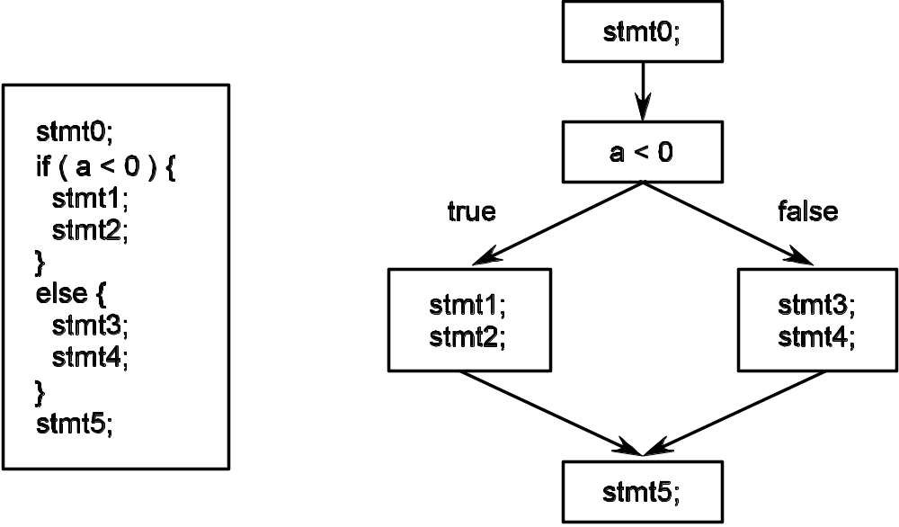
Clear-box Testing
Once the internals of a method are known, additional tests might be suggested. That is, provide additional oracles based on what is known about the implementation
Path coverage – test all possible paths through the code (!!)

Slide 19
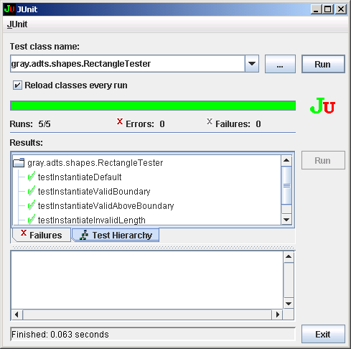
Testing with JUnit
The green bar of happiness;
all tests passed!
Names of the testing methods
corresponding to the oracles
you prepared. A green check
mark means the test passed.

Slide 20
JUnit Basics
TestCase: The class your test class should extend to get the JUnit support methods
Test fixture: instance(s) of the class to be tested
import JUnit.framework.*; // JUnit stuff
import JUnit.extensions.*; // JUnit stuff
import gray.adts.shapes.Rectangle; // the class to test
public class RectangleTester extends TestCase {
private Rectangle r1, r2; // test fixture; stores the Rectangle
_{// objects under test}
To inherit the testing and test
run methods we will need

Slide 21
JUnit Basics: setUp() and tearDown()
/* Called AUTOMATICALLY before EACH testXXX() method is run. */
_{protected void setUp() {}
_{r1 = new Rectangle();}
r2 = new Rectangle( 2.0, 3.0 );
}
/* Called AUTOMATICALLY after EACH testXXX() method is run. */
_{protected void tearDown() {}
_{r1 = null;}
_{r2 = null;}
}
Make sure each test method starts
with a clean copy of the test fixture.
This is the sequence of calls the JUnit framework does for you automatically for each test method that is invoked.
setUp(); // establish the test fixture
_{testXXX(); // run the test}
tearDown(); // do house cleaning

Slide 22
Coding an Oracle as a JUnit Test Method
/**
Test Case 2.1: Verify that instantiation was done properly using
default values for the Rectangle’s dimensions.
*/
public void testInstantiateDefault() {
assertEquals( 1.0, r1.getLength() );
assertEquals( 1.0, r1.getHeight() );
}
_{methods provided by JUnit}
/**
Test Case 2.6: Verify mutator for length catches illegal input.
*/
public void testMutatorIllegalInput() {
_{try {}
r1.setLength( 0 ); // 0 is illegal; exception should be thrown
fail( “Should raise IllegalArgumentException”);
} catch ( IllegalArgumentException e ) {
assertTrue(true); // expected an exception, so the test passes
}
}
Remember:
setUp() will have been called prior to
each test method getting called, creating
test object r1 anew for each test

Slide 23
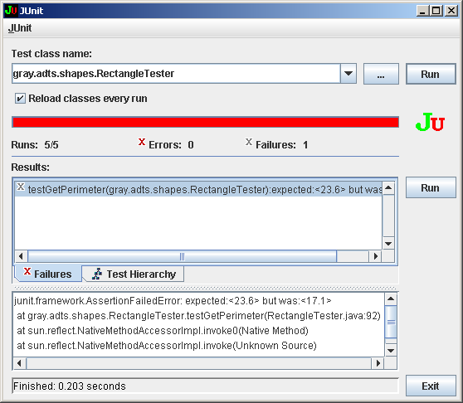
When a Test Fails
The red bar of sadness;
some tests failed
Names of the testing methods
corresponding to the oracles
you prepared. A red X means
the test failed.
Stack trace telling what was
expected, what was generated
and where the test failed;
very handy!

Slide 24
Analysis and Measurement
An algorithm’s performance can be described by its:
time complexity – how long it takes to execute. In general, our preference is for shorter execution times rather than longer ones
space complexity – how much additional space the algorithm needs. If the amount of additional memory needed is a function of the algorithm’s input size, we prefer “smaller” functions

Slide 25
Time Complexity: Count Instructions
 | Statements | Cost
1 | float findAvg1D( int []a, int n ) {
2 | float sum = 0; | 1
3 | int count = 0; | 1
4 | while ( count < n ) { | n + 1
5 | sum += grades[count]; | n
6 | count++; | n
7 | }
8 | if ( n > 0 ) | 1
9 | return sum / n;
10 | else | 1
11 | return 0.0f;
12 | }
 | TOTAL | 3n + 5
How many times
will each instruction
execute?

Slide 26
Theta (Θ) Notation
A function f(n) is Θ(g(n)) if there are positive
constants c₁, c₂, and n₀ such that
0 ≤ c₁g(n) ≤ f(n) ≤ c₂g(n) for all n ≥ n₀.
This means that for all n ≥ n₀, the graph of f(n)
falls between c₁g(n) and c₂g(n).

Slide 27
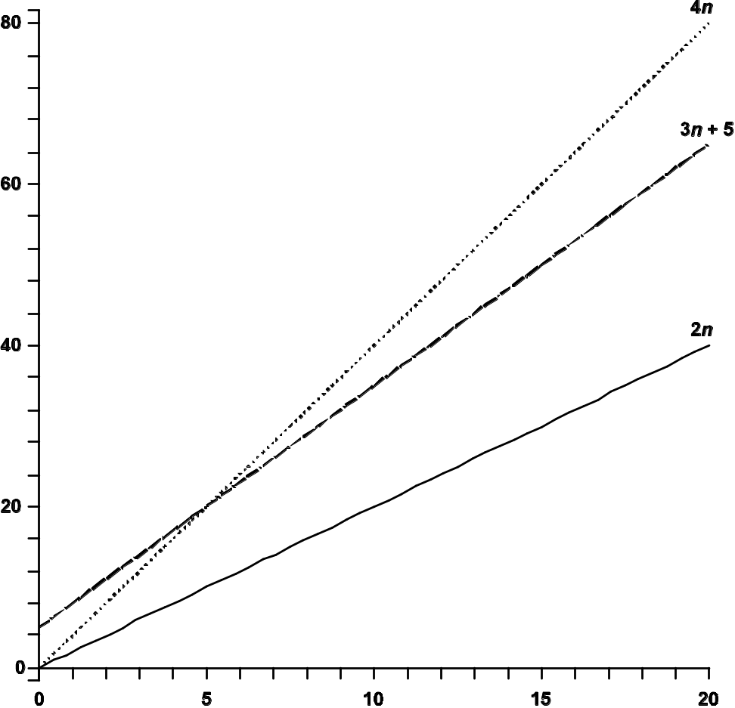
Theta (Θ) Example: findAvg1d()
T_{findAvg1D}(n) = Θ(n), for c₁ = 2, c₂ = 4, n₀ = 5
4n
3n + 5
2n
0 ≤ 2n ≤ 3n + 5 ≤ 4n

Slide 28
Big-Oh (Ο) Notation
A function f(n) is Ο(g(n)) if there are positive constants c and n₀ such that f(n) ≤ cg(n) for all n ≥ n₀.
What we are saying is that f(n) will grow no faster than a multiple of g(n); hence g(n) is an upper bound on the growth rate of f(n).

Slide 29
Linear Search
 | Statements | Cost
1 | int linearSearch( int []a, int n, int target ) {
2 | int i = 0; | 1
3 | while ( i < n ) { | n + 1
4 | if ( target == array[i] ) | n
5 | return i; | 1
6 | i++; | n
7 | }
8 | return –1; | 1
9 | }
 | TOTAL | 3n + 3
Note: Only 1 return statement will execute,
so the total is 3n + 3 and not 3n +4

Slide 30
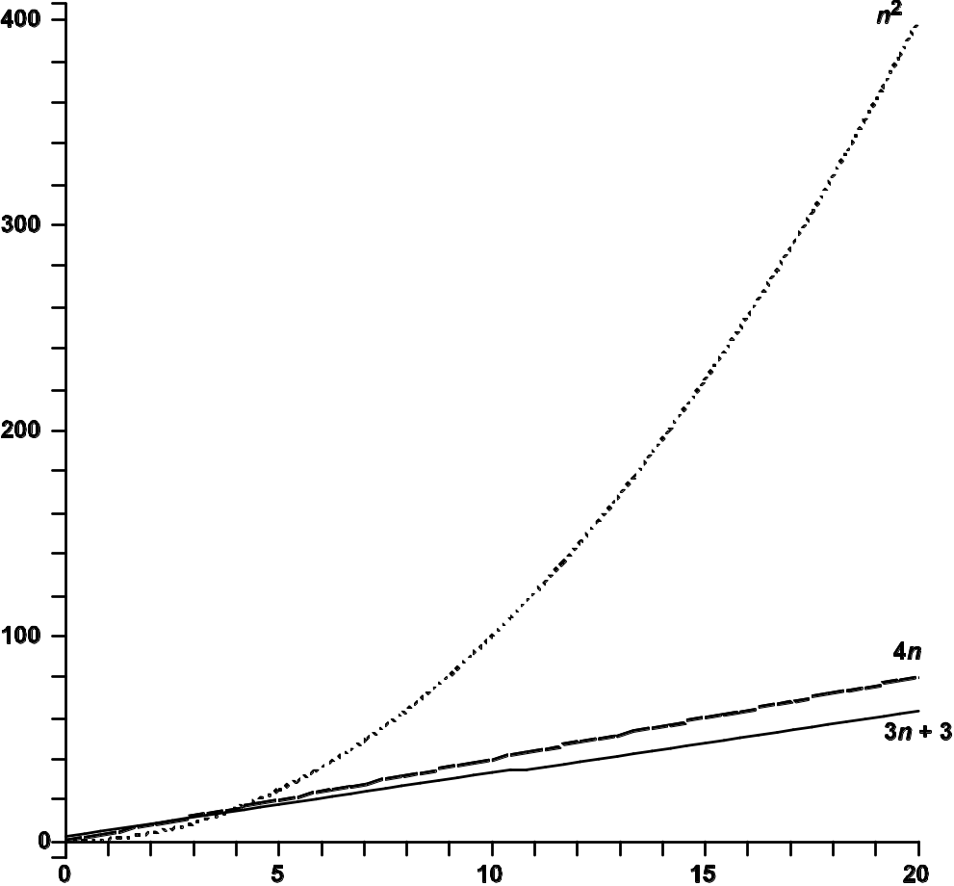
Big-Oh (Ο): Linear Search
T_{linearSearch}(n) = 3n + 3 = Ο(n) for c = 4 and n₀ = 0,
in the worst case.
n²
T_{linearSearch}(n) = Ο(n²)
But this is an abuse of
O-notation
4n
3n + 3

Slide 31
Constant Time Algorithms: O(1)
O(1): the number of instructions
executing is independent of
the size of the input
int medianOf3( int []a, int n ) {
int v1 = a[0];
int v2 = a[n/2];
int v3 = a[n-1];
if ( (v1 < v2 ) && ( v1 < v3 ) ) // v1 is smallest
if ( v2 < v3 )
return n/2; // middle position
else return n - 1; // last position
else if ( ( v2 < v1 ) && ( v2 < v3 ) ) // v2 smallest
if ( v1 < v3 )
return 0; // first position
else return n – 1; // last position
else // v3 is smallest
if ( v1 < v2 )
return 0; // first position
else return n / 2; // middle position
}

Slide 32
Some Common Computing Times
log₂n | n | n log₂n | n² | 2^{n}
1 | 2 | 2 | 4 | 4
2 | 4 | 8 | 16 | 16
3 | 8 | 24 | 64 | 256
4 | 16 | 64 | 256 | 65,536
5 | 32 | 160 | 1,024 | 4,294,967,296
6 | 64 | 384 | 4,096 | 1.84 × 10¹⁹
7 | 128 | 896 | 16,384 | 3.40 × 10³⁸
8 | 256 | 2,048 | 65,536 | 1.16 × 10⁷⁷
9 | 512 | 4,608 | 262,144 | 1.34 × 10¹⁵⁴
10 | 1,024 | 10,240 | 1,048,576 | 1.80 × 10³⁰⁸

Slide 33
Algorithm Measurement
Asymptotic analysis doesn’t always tell the full story. Asymptotically, finding the largest value in an array of ints and an array of Integer objects is the same, but in reality…
Pseudocode: for timing an algorithm
1. initialize the data structure; totaltime = 0
2. for n iterations
3. get the starting time
4. run the algorithm
5. get the finish time
6. totaltime = totaltime + ( finish time – start time)
7. average time = total time / n

Slide 34
Algorithm Measurement
Use System.currentTimeMillis() to get the current time in milliseconds
  Measuring execution time is limited by the resolution of the clock
  System activity can affect timing
  Run the garbage collector before doing a timing to minimize the likelihood it will run during a timing

Slide 35
Algorithm Measurement: A Code Fragment
// allocate & initialize int array with values from SIZE - 1 to 0
intArray = new int[SIZE];
for ( int j = 0, i = SIZE - 1; i >= 0; j++, i-- )
intArray[j] = i;
// find the largest value in the int array
for ( int i = 0; i < NUM_ITERATIONS; i++ ) {
int largest = intArray[0];
start = System.currentTimeMillis();
for ( int j = 1; j < SIZE; j++ )
if ( intArray[j] > largest )
largest = intArray[j];
finish = System.currentTimeMillis();
intArrayTimeTotal += finish - start;
}
// force cleanup to prevent it happening while
// looking for the largest in the Integer array
intArray = null; // make the array garbage
System.gc(); // invoke the garbage collector
Get the start time
Get the finish time
Cleanup between
timings

Slide 36
Some Astonishing Results?
n | array of int | array of Integer
4,000,000 | 11.363 | 21.739
8,000,000 | 22.727 | 42.958
800,000 | 2.314 | 4.329
Timings for findMax() on an array of ints and an
array of Integers (times are in milliseconds)

